Slide 1
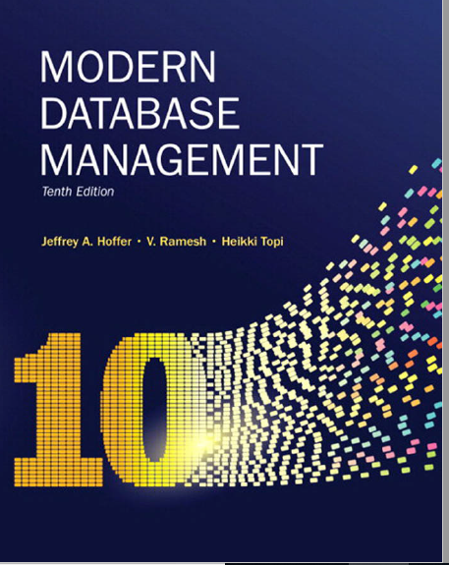
Chapter 6: Introduction to SQL
DDL: Table and Constraints

Slide 2
Objectives
Define terms
Interpret history and role of SQL
Define a database using SQL data definition language
Write single table queries using SQL
Establish referential integrity using SQL
Discuss SQL:1999 and SQL:200n standards

Slide 3
SQL Overview
Structured Query Language
The standard for relational database management systems (RDBMS)
RDBMS: A database management system that manages data as a collection of tables in which all relationships are represented by common values in related tables
Notes:
Structured Query Language
The standard for relational database management systems (RDBMS) - all major relational database comply with SQL standards
RDBMS: A database management system that manages data as a collection of tables in which all relationships are represented by common values in related tables

Slide 4
History of SQL
1970–Edgar Codd develops relational database concept
1974-1979–System R with Sequel (later SQL) created at IBM Research Lab
1979–Oracle markets first relational DB with SQL
1981 – SQL/DS first available RDBMS system on DOS/VSE
Others followed: INGRES (1981), IDM (1982), DG/SGL (1984), Sybase (1986)
1986–ANSI SQL standard released
1989, 1992, 1999, 2003, 2006, 2008, 2011, 2016 –Major ANSI standard updates
Today – S Q L is supported by most major database vendors
Notes:
SQL/DS -> SQL/Data Systems – IBMs first commercial RDBMS.
DOS/VSE – operating system for IBM’s mainframes computer
Current–SQL is supported by most major database vendors
Oracle, MySQL, Postgress, DB2 etc
ANSI-American National Standards Institute
Latest version ANSI:sql 2016 to support JSON data structures

Slide 5
Original Purpose of SQL Standard
Specify syntax/semantics for data definition and manipulation
Define data structures and basic operations
Enable portability of database definition and application modules
Allow for later growth/enhancement to standard
Notes:
Specify syntax/semantics for DML and DDL
Define data structures and basic operations
Enable portability of database definition and application modules
Specify minimal (level 1) and complete (level 2) standards
Allow for later growth/enhancement to standard

Slide 6
What are the benefits of a Standardized Relational Language?
Notes:
Reduced training costs
Productivity
Application portability
Application longevity
Reduced dependence on a single vendor
Cross-system communication

Slide 7
Benefits of a Standardized Relational Language
Reduced training costs
Productivity
Application portability
Application longevity
Reduced dependence on a single vendor
Cross-system communication
Notes:
Reduced training costs
Productivity
Application portability
Application longevity
Reduced dependence on a single vendor
Cross-system communication

Slide 8
SQL Environment
Catalog
A set of schemas that constitute the description of a database
Schema
The structure that contains descriptions of objects created by a user (base tables, views, constraints)
Data Definition Language (DDL)
Commands that define a database, including creating, altering, and dropping tables and establishing constraints
Data Manipulation Language (DML)
Commands that maintain and query a database
Data Control Language (DCL)
Commands that control a database, including administering privileges and committing data
Notes:
The system catalog consists of tables describing the structure of objects such as databases, base tables, views, and indices
Catalog -> describes the database / all meta data
Schema -> describes objects created by user ( tables, views, constraints)
DDL – create, drop, alter
DML – changing data
DCL – privileges, security

Slide 9
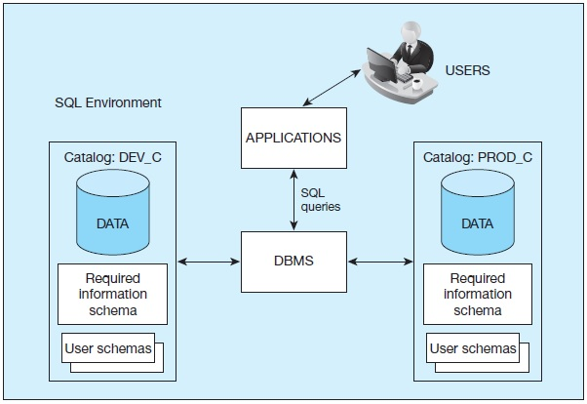
Figure 6-1
A simplified schematic of a typical SQL environment, as described by the SQL: 200n standard

Slide 10
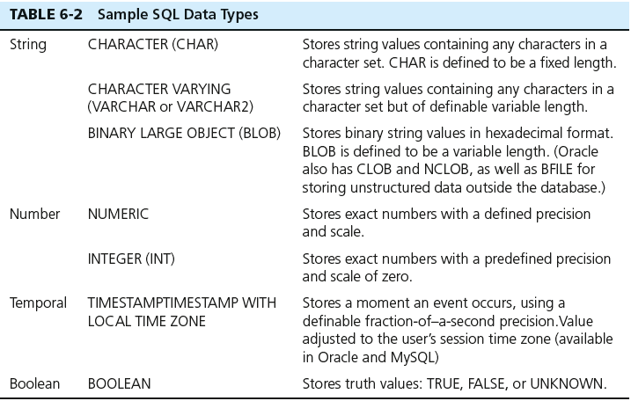
SQL Data Types

Slide 11
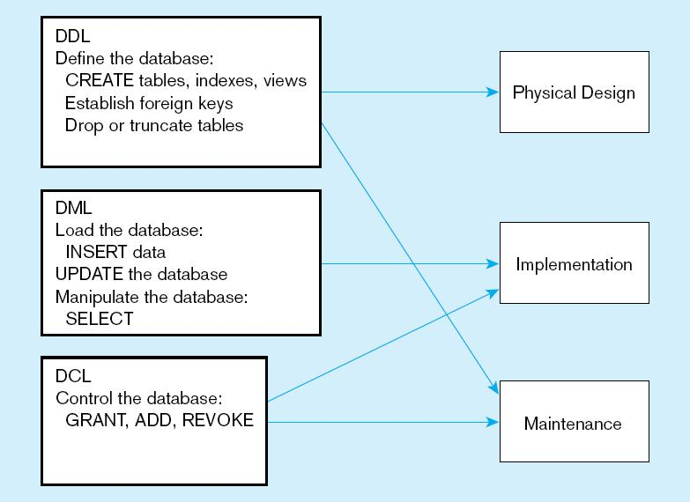
Figure 6-4
DDL, DML, DCL, and the database development process

Slide 12
SQL Database Definition
Data Definition Language (DDL)
Major CREATE statements:
CREATE SCHEMA–defines a portion of the database owned by a particular user
CREATE TABLE–defines a new table and its columns
CREATE VIEW–defines a logical table from one or more tables or views
Other CREATE statements: CHARACTER SET, COLLATION, TRANSLATION, ASSERTION, DOMAIN
Notes:
CREATE SCHEMA
CREATE TABLE
CREATE VIEW
CREATE INDEX
CREATE STORED PROCEDUCTION
CREATE FUNCTION

Slide 13
Steps in Table Creation
Identify data types for attributes
Identify columns that can and cannot be null
Identify columns that must be unique (candidate keys)
Identify primary key–foreign key mates
Determine default values
Identify constraints on columns (domain specifications)
Create the table and associated indexes

Slide 14
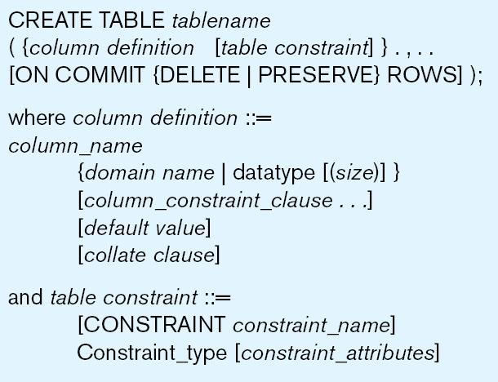
Table Creation
Figure 6-5 General syntax for CREATE TABLE statement used in data definition language
Notes:
1 Identify data types for attributes – the name of each column, and their data types
2 Identify columns that can and cannot be null – optional
3 Candidate key, and primary keys
5 default values
6 Constraints
7 tables and constraints

Slide 15
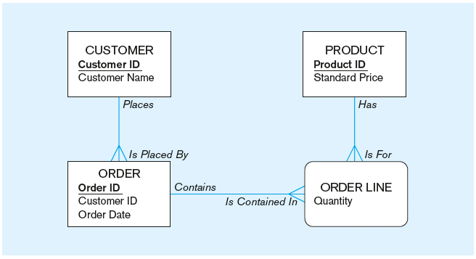
The following slides create tables for this enterprise data model
(from Chapter 1, Figure 1-3)

Slide 16
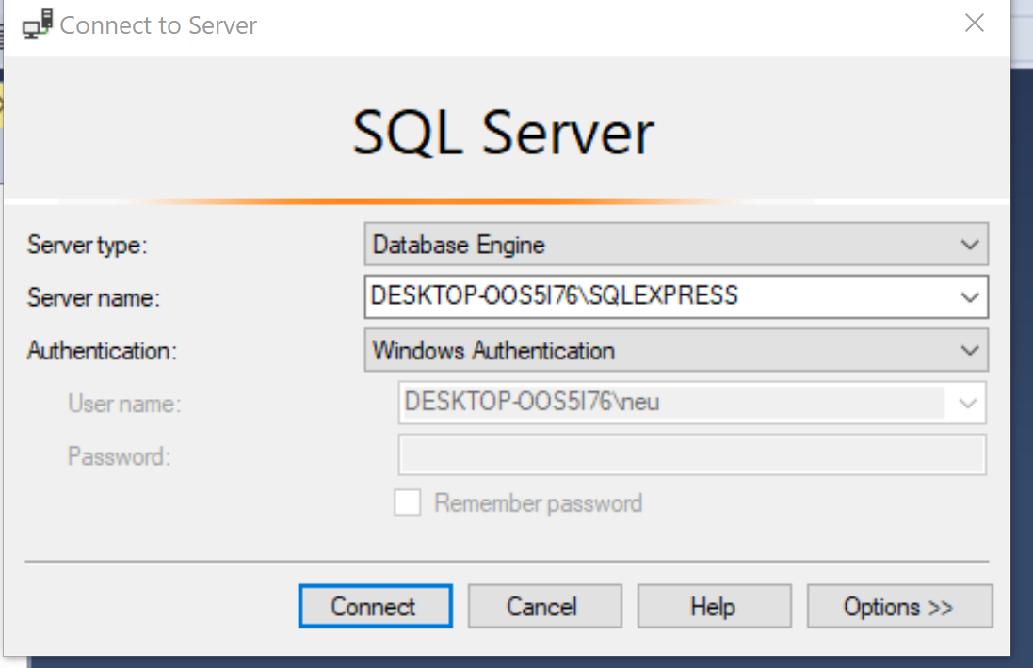
Connect to the Database Engine
Notes:
If you are running Windows on a PC, or a docker container and using SQL Server Management Studio as the client to connect to the database
DBWeaver or other clients for mac!.
Authentication: windows Auth, may be others

Slide 17
Defining attributes and their data types
CREATE TABLE Customer
(
CustomerID int not null,
CustomerName nvarchar(25),
CustomerAddress varchar(30),
CustomerCity varchar(20),
CustomerState char(2),
CustomerPostalCode varchar(9)
CONSTRAINT Customer_PK primary key (CustomerID )
);

Slide 18
Non-nullable specification
CREATE TABLE Customer
(
CustomerID int not null,
CustomerName nvarchar(25),
CustomerAddress varchar(30),
CustomerCity varchar(20),
CustomerState char(2),
CustomerPostalCode varchar(9)
CONSTRAINT Customer_PK primary key (CustomerID )
);

Slide 19
Identifying Primary keys
CREATE TABLE Customer (
CustomerID int not null,
CustomerName nvarchar(25),
CustomerAddress varchar(30),
CustomerCity varchar(20),
CustomerState char(2),
CustomerPostalCode varchar(9)
CONSTRAINT Customer_PK primary key (CustomerID )
);
Primary keys can never have NULL values
Simple primary key
CREATE TABLE OrderLine (
OrderID int not null,
ProductID int not null,
OrderQuantity smallint,
CONSTRAINT OrderLine_PK PRIMARY KEY (OrderID, ProductID),
CONSTRAINT OrderLine_FK1 FOREIGN KEY (OrderID) REFERENCES [Order] (OrderID),
CONSTRAINT OrderLine_FK2 FOREIGN KEY( ProductID) REFERENCES Product(ProductID)
);
Composite PK

Slide 20
Controlling the values in attributes
CREATE TABLE [Order]
(
OrderID int not null,
OrderDate Datetime default ( getdate()) ,
CustomerID int not null
CONSTRAINT Order_PK PRIMARY KEY (OrderID),
CONSTRAINT Order_FK FOREIGN KEY (CustomerID) references Customer(CustomerID) );
Default value
CREATE TABLE Product (
ProductID int not null,
ProductDescription varchar(50),
ProductFinish varchar(20) CONSTRAINT ProductFinish_CHK CHECK ( ProductFinish IN ('Cherry',
'Natural Ash', 'White Ash', 'Red Oak',
'Natural Oak', 'Walnut') ),
ProductStandardPrice DECIMAL(6,2),
ProductLineIDint,
CONSTRAINT Product_PK PRIMARY KEY (ProductID)
);
Domain constraint
Domain constraints

Slide 21
Establishing foreign key primary key relationship
CREATE TABLE Customer (
CustomerID int not null,
CustomerName nvarchar(25),
CustomerAddress varchar(30),
CustomerCity varchar(20),
CustomerState char(2),
CustomerPostalCode varchar(9)
CONSTRAINT Customer_PK primary key (CustomerID )
);
Primary key of parent table
CREATE TABLE [Order](
OrderID int not null,
OrderDate Datetime default ( getdate()) ,
CustomerID int not null
CONSTRAINT Order_PK PRIMARY KEY (OrderID),
CONSTRAINT Order_FK FOREIGN KEY (CustomerID) references Customer(CustomerID)
);
Foreign key of dependent table

Slide 22
Data Integrity Controls
Referential integrity–constraint that ensures that foreign key values of a table must match primary key values of a related table in 1:M relationships
Restricting:
Deletes of primary records
Updates of primary records
Inserts of dependent records
Notes:
ensures that foreign key values of a table must match primary key values
3 TYPES OF restricting on how to main the data integrity

Slide 23
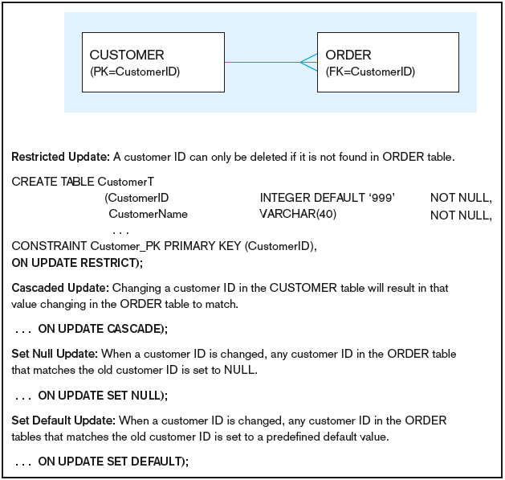
Figure 6-7 Ensuring data integrity through updates
Relational integrity is enforced via the primary-key to foreign-key match
Notes:
Draw a customer and order with sample data:
Restricted UPDATE
CASCADE UPDATE
UPDATE SET TO NULL
UPDATE SET TO DEFUALT (LIKE 9999)

Slide 24
[ CONSTRAINT constraint_name ]
{
{ PRIMARY KEY | UNIQUE }
[ CLUSTERED | NONCLUSTERED ]
(column [ ASC | DESC ] [ ,...n ] )
[ WITH FILLFACTOR = fillfactor
[ WITH ( <index_option>[ , ...n ] ) ]
[ ON { partition_scheme_name ( partition_column_name ... )
| filegroup | "default" } ]
| FOREIGN KEY
( column [ ,...n ] )
REFERENCES referenced_table_name [ ( ref_column [ ,...n ] ) ]
[ ON DELETE { NO ACTION | CASCADE | SET NULL | SET DEFAULT } ]
[ ON UPDATE { NO ACTION | CASCADE | SET NULL | SET DEFAULT } ]
[ NOT FOR REPLICATION ]
| CONNECTION
( { node_table TO node_table }
[ , {node_table TO node_table }]
[ , ...n ]
)
[ ON DELETE { NO ACTION | CASCADE } ]
| DEFAULT constant_expression FOR column [ WITH VALUES ]
| CHECK [ NOT FOR REPLICATION ] ( logical_expression )
}
Notes:
SQL SERVER SYNTAX

Slide 25
DEFAULT BEHAVIOR
CUSTOMER
CustomerID | CustomerName | CustomerType | ZipCode
1 | John Doe | Residential | 02024
2 | Sarah Lee | Residential | 02165
ORDER
OrderID | CustomerID | OrderDate
1000 | 2 | 9/23/2019
1001 | 2 | 9/27/2019
Notes:
What happens if I delete the record with CustomerID =1 From Customer Table? Will the records be deleted? Yes, no corresponding record in ORDER table
What happens if I delete the record with CustomerID =2 From Customer Table? Will the records be deleted? No, Existing ORDER table

Slide 26
ON DELETE CASCADE
CUSTOMER
CustomerID | CustomerName | CustomerType | ZipCode
1 | John Doe | Residential | 02024
2 | Sarah Lee | Residential | 02165
ORDER
OrderID | CustomerID | OrderDate
1000 | 2 | 9/23/2019
1001 | 2 | 9/27/2019
Notes:
What happens if I delete the record with CustomerID =1 From Customer Table? Will the records be deleted? Yes, no corresponding record in ORDER table
What happens if I delete the record with CustomerID =2 From Customer Table? Will the records be deleted? YES, and both records from ORDER will be deleted

Slide 27

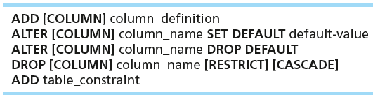
Changing Tables
ALTER TABLE statement allows you to change column specifications:
Table Actions:
Example (adding a new column with a default value):
ALTER TABLE Customer ALTER column CustomerType varchar(20)
Notes:
-- Add new column
ALTER TABLE Customer ADD CustomerType varchar(2) default ( 'Commercial')
-- Add new column
ALTER TABLE Customer ALTER column CustomerType varchar(20)

Slide 28
Removing Tables
DROP TABLE statement allows you to remove tables from your schema:
DROP TABLE CUSTOMER
Notes:
By removing the table, you are also destroying the data.
Msg 3726, Level 16, State 1, Line 1
Could not drop object 'CUSTOMER' because it is referenced by a FOREIGN KEY constraint.

Slide 29
Constraints and DDL
Msg 3726, Level 16, State 1, Line 1
Could not drop object 'CUSTOMER' because it is referenced by a FOREIGN KEY constraint.

Slide 30
DROP TABLE
DROP TABLE OrderLine
DROP TABLE [Order]
DROP TABLE Product
DROP TABLE Customer
Notes:
Drop table in the reserve order on how they were created

